Slide 1
19AIE431: APPLIED CRYPTOGRAPHY
TEAM-14
IMPLEMENTING BLOCKCHAIN IN PYTHON

Slide 2

PS Ganesan (CB.EN.U4CSE19233)
Devisetty Mithil Sri Sai (CB.EN.U4AIE19023)
Rohith G (CB.EN.U4AIE19026)
Shiva Rupan S (CB.EN.U4AIE19059)
Vijai Simmon S (CB.EN.U4AIE19068)

Slide 3
TABLE OF CONTENTS
Introduction
Hashing
SHA-256
Codes
Advantages
Drawbacks
Conclusion

Slide 4
An Introduction to Blockchain

Slide 5
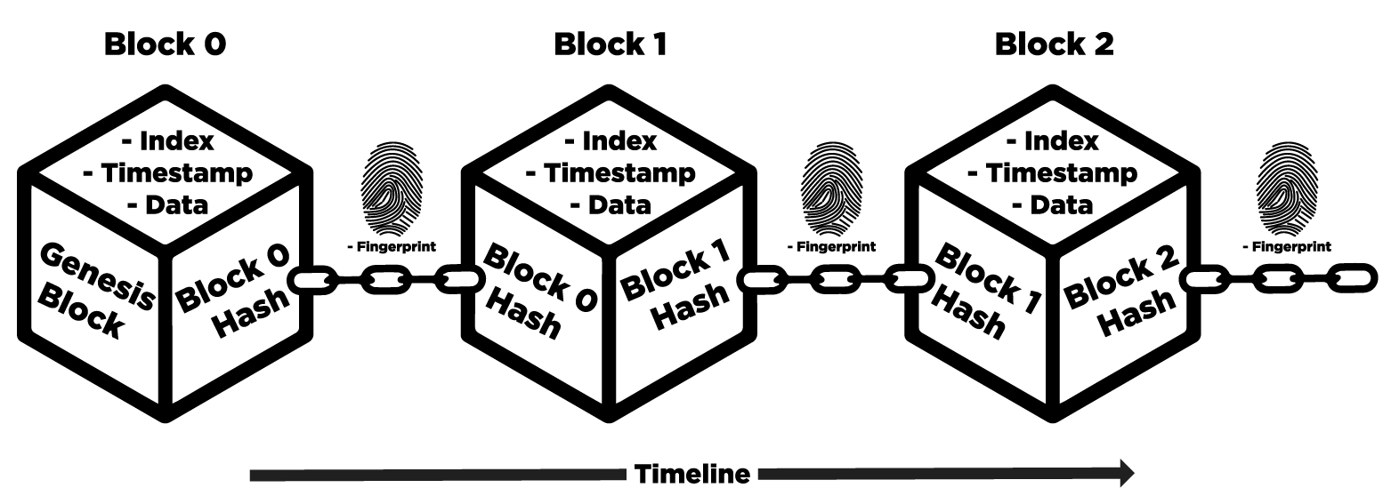
Blockchains
A blockchain refers to a group of blocks that contain information
Original use case: It was used to store the timestamps of important digital documents so that predating or postdating them can be prevented
Source: https://w3bt.io/what-is-the-blockchain-and-how-does-it-work/

Slide 6
Every block in a blockchain has 3 fields: data, hash of the data, hash of the predecessor block
Immutability: Blockchain can also be considered as sort of a ledger in which anybody can make a one-time entry. Changing the entry in the ledger would mean gaining the permission of all those who use the ledger.
Distributed nature: there is no central entity managing the whole chain. In other words, all nodes/blocks are connected in a peer-to-peer network.
Consensus: Every node will have its own copy of the entire blockchain. In order to add a block to the chain, every node in the chain has to give its consensus for the block to be added to its own copy of the chain.
Mining: It adds security to the blockchain by making it difficult to add new blocks to an existing chain

Slide 7
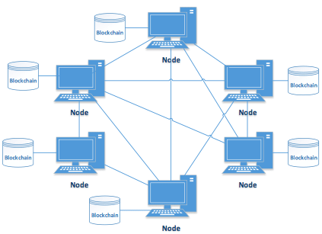
Source: Blockchain Implementation Quality Challenges: A Literature Review, Bojana Koteska, Elena Karafiloski, Anastas Mishev B

Slide 8
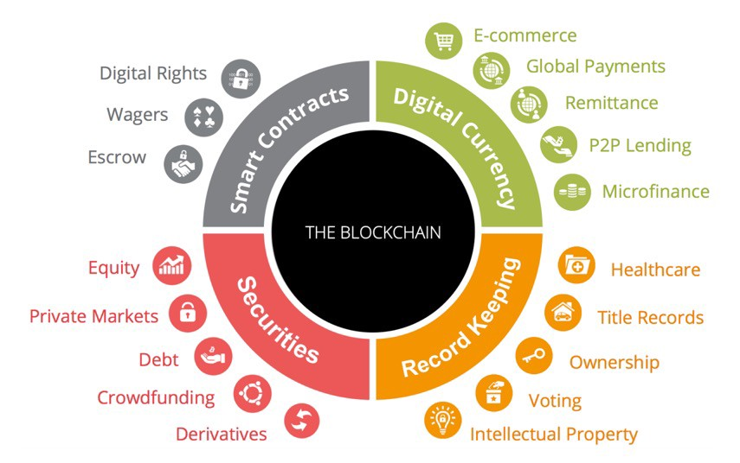
Depending on where they are used, the blocks can house different types of data: bank transaction history, customer credentials, medical records, tax records, and other important documents.
Source: https://u.osu.edu/introtoblockchain/what-this-means-for-the-future/

Slide 9
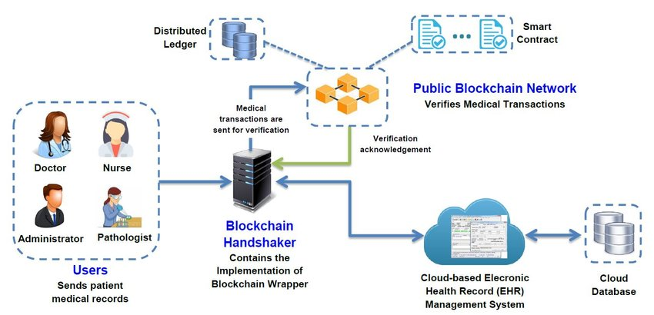
Here, we can observe four key components in the architecture: user application, blockchain handshaker, cloud, and public blockchain network.
Source:https://www.researchgate.net/figure/Proposed-System-Architecture-of-Blockchain-based-Electronic-Health-Record-Management_fig2_334343944

Slide 10
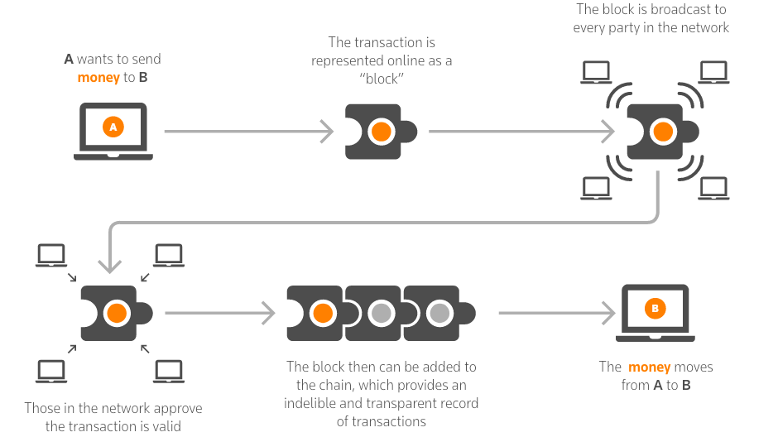
Source:https://www.thomsonreuters.com/en-us/posts/tax-and-accounting/blockchain-impact-tax-and-accounting-industry/
This example shows how the information moves through distributed ledgers in “blocks”, using money as an example.

Slide 11
Hashing

Slide 12
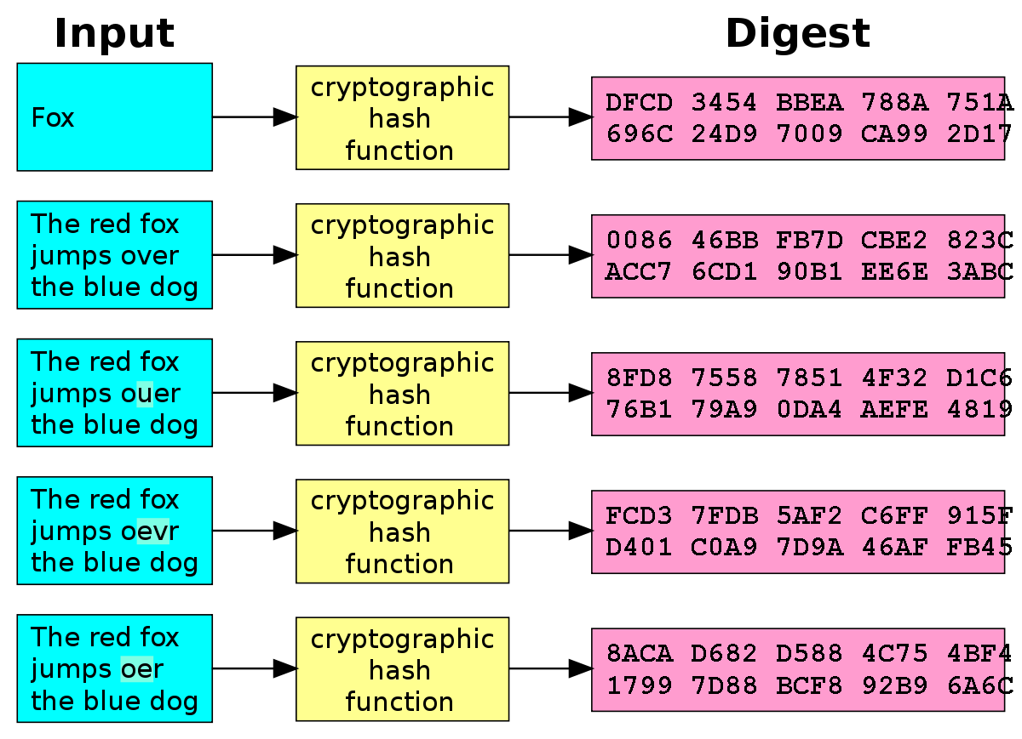
In simple words, mapping input data to one amongst a very large set of numbers is called hashing.
Source: https://en.wikipedia.org/wiki/Cryptographic_hash_function

Slide 13
Just like encryption, an input is converted to a completely new entity.However, unlike encryption, the result may not be the same size the original data.
Ex: For input strings of any length, the SHA-256 will returns only a 256-bit binary value.
Also, unlike encryption, the original data cannot be retrieved, and it is other words, hashing is a one-way process.
A couple of applications of hashing have been given in the following slides.

Slide 14
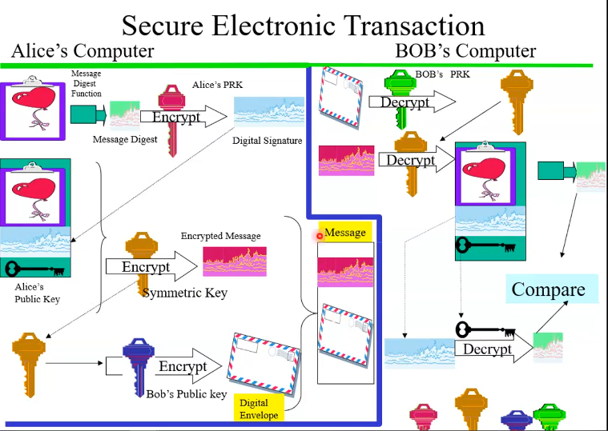
Document transfer

Slide 15
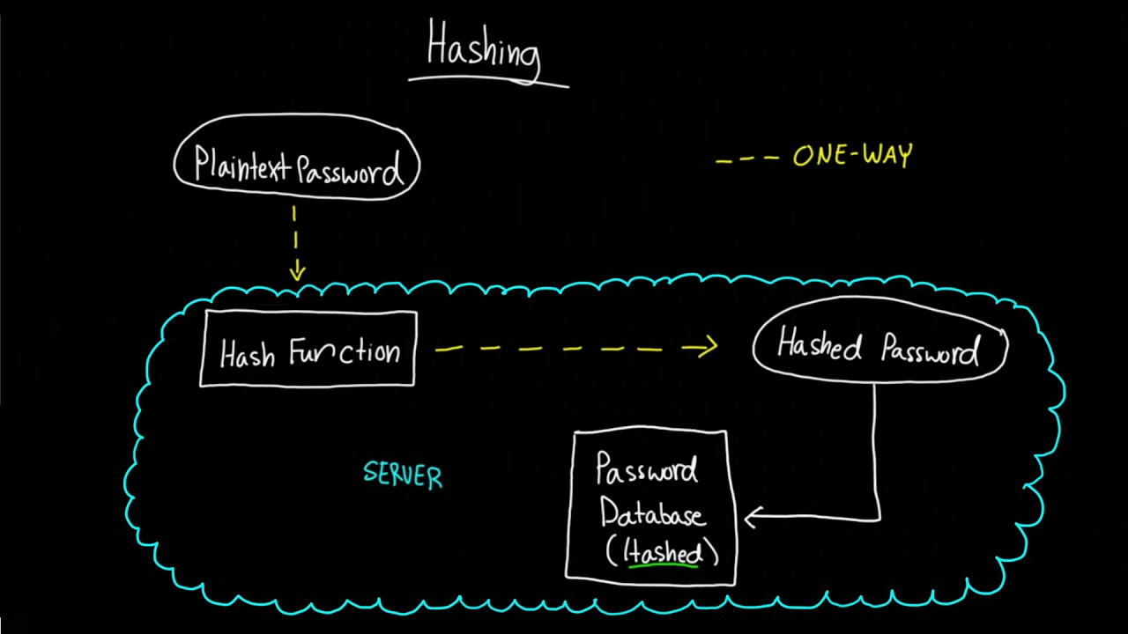
2) Hashing passwords
Source: Youtube - Hashing and Password Storage (How to Store Passwords)

Slide 16
SHA-256

Slide 17
SHA256 is a patented cryptographic hash function that belongs to the family of SHA-2 (Secure Hash Algorithm 2), which happens to be the successor of SHA-1
In the cybersecurity realm, SHA-256 is used in implementing authentication and encryption protocols like:
SSL (Secure Socket Layer)
TLS (Transport Layer Security)
IPsec (Internet Protocol Security)
SSh (Secure Shell)
PGP (Pretty Good Privacy)
Unix uses SHA256 for secure password hashing. Cryptocurrencies such as Bitcoin use SHA256 for verifying transactions.

Slide 18
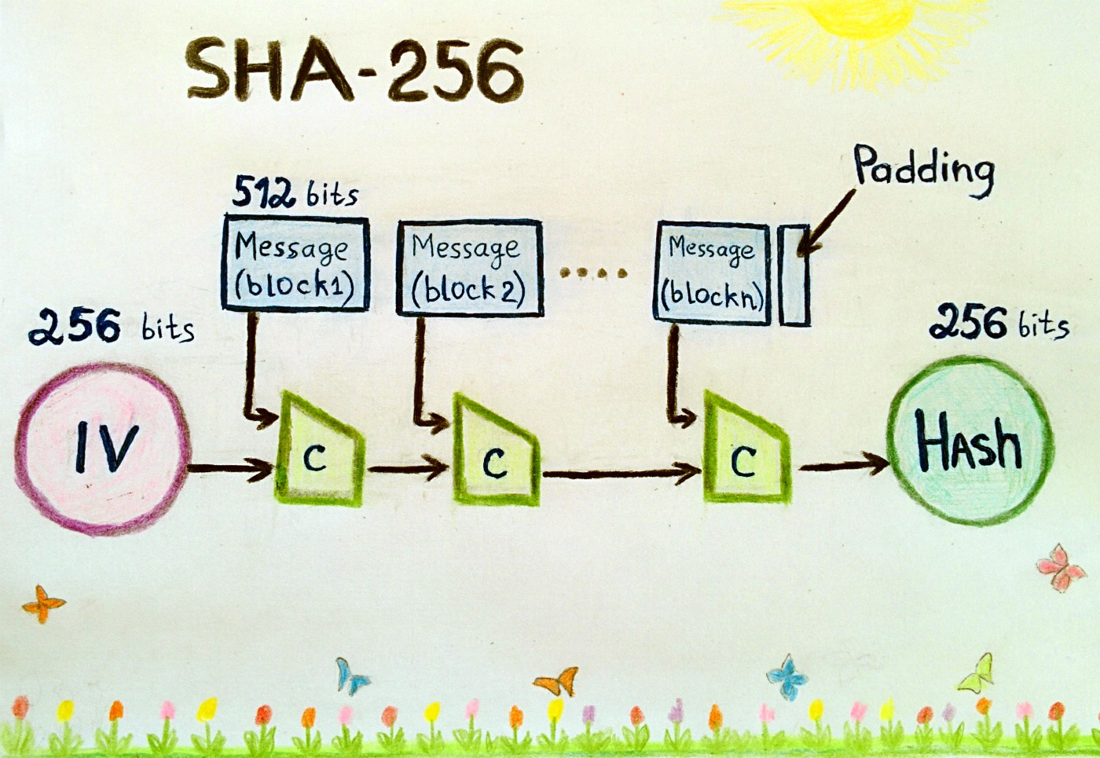
Source: https://en.bitcoinwiki.org/wiki/SHA-256

Slide 19
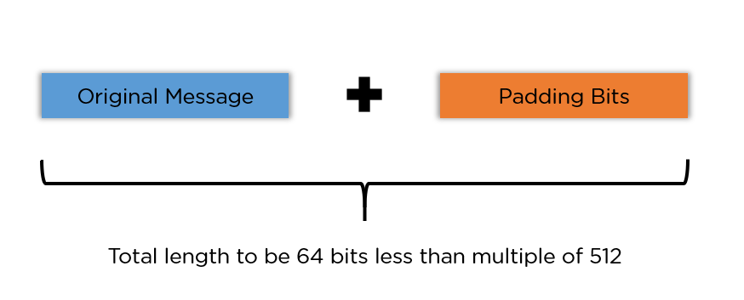
Steps in SHA-256 Algorithm
STEP 1: Padding Bits
Initially, it adds some extra bits to the message, such that the length is exactly 64 bits short of a multiple of 512.
During the addition, the first bit should be one, and the rest of it should be filled with zeroes.

Slide 20
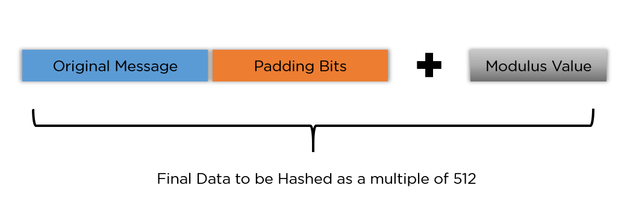
Steps in SHA-256 Algorithm
STEP 2: Padding Length
Now, we will add 64 bits of data now to make the final plaintext a multiple of 512.
Next, we can calculate these 64 bits of characters by applying the modulus to your original cleartext without the padding.

Slide 21
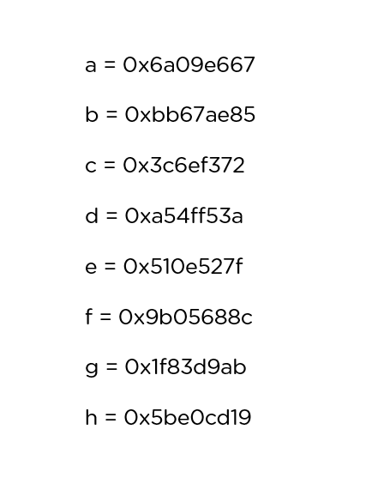
Steps in SHA-256 Algorithm
STEP 3: Initialising the Buffers
Now, we need to initialize the default values for eight buffers to be used in the rounds as follows:
It is also required to store 64 different keys in an array, ranging from K[0] to K[63].

Slide 22
Steps in SHA-256 Algorithm
STEP 4: Compression Functions
The entire message gets broken down into multiple blocks of 512 bits each.
It puts each block through 64 rounds of operation, with the output of each block serving as the input for the following block.

Slide 23
Steps in SHA-256 Algorithm
Output
With each iteration, the final output of the block serves as the input for the next block.
The entire cycle keeps repeating until you reach the last 512-bit block, and you then consider its output the final hash digest.
This digest will be of the length 256-bit, as per the name of this algorithm.

Slide 24
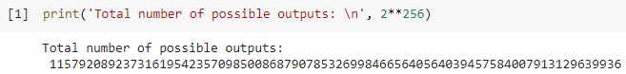
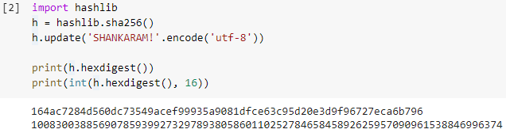
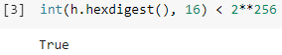
SHA-256 gives a 256-bit length output. Therefore, number of possible outcomes = 2²⁵⁶
Hexadecimal hash
Integer /decimal equivalent of hexadecimal hash

Slide 25
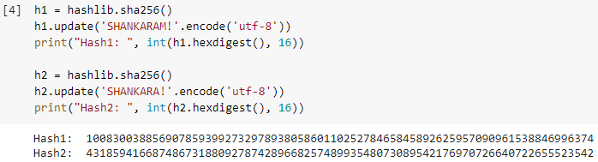
Even if two inputs are very similar, the corresponding hashes can be very different. For instance, the below two inputs very much resemble one another, however, their hashes are very different:

Slide 26
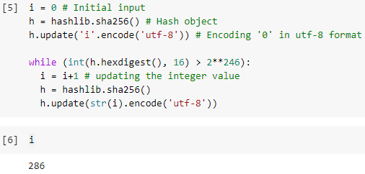
Mining a Hash

Slide 27
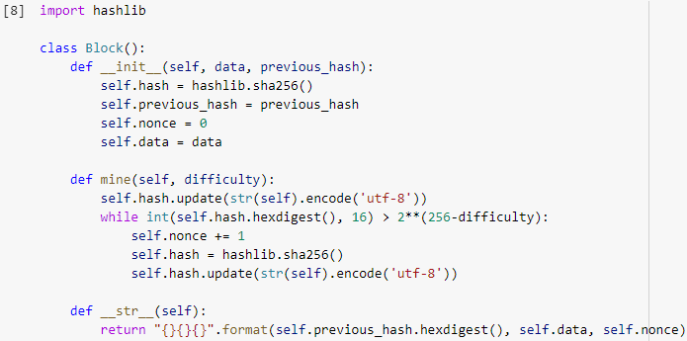
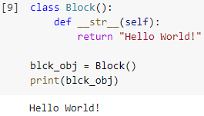
class ‘Block’

Slide 28
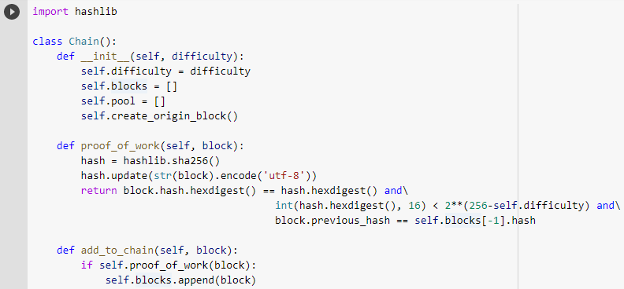
class ‘Chain’

Slide 29
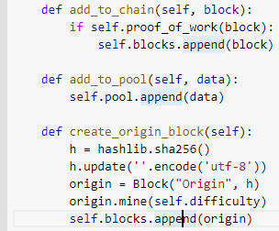
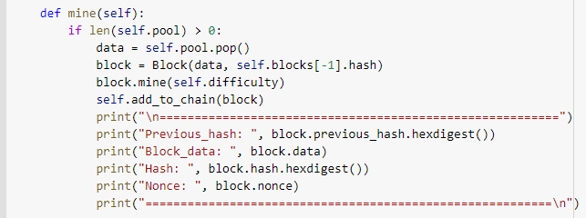

Slide 30
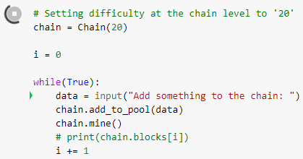
Main codescript

Slide 31
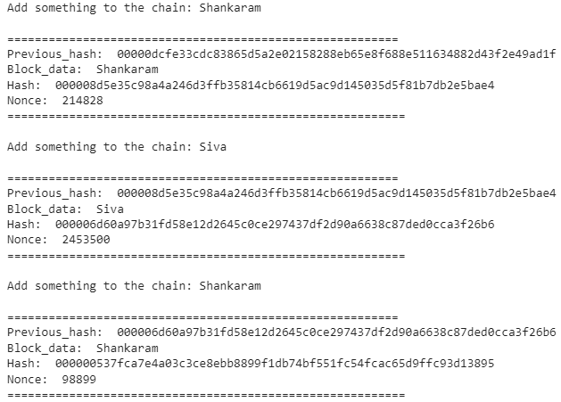
Functioning of the chain

Slide 32
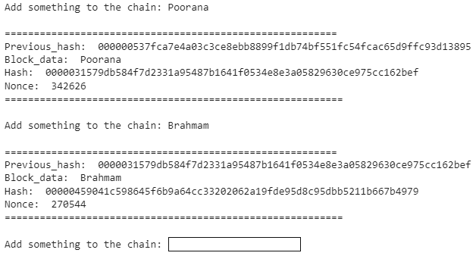

Slide 33
A simple Blockchain-based voting system

Slide 34
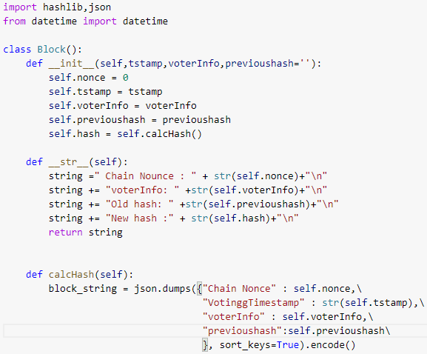
class ‘Block’

Slide 35
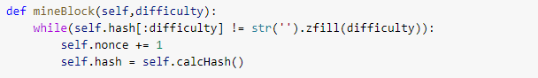
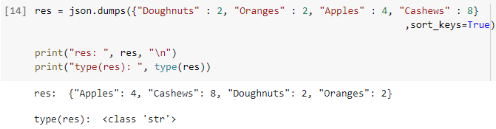
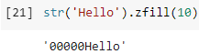
Example usage of json.dumps() & zfill()

Slide 36
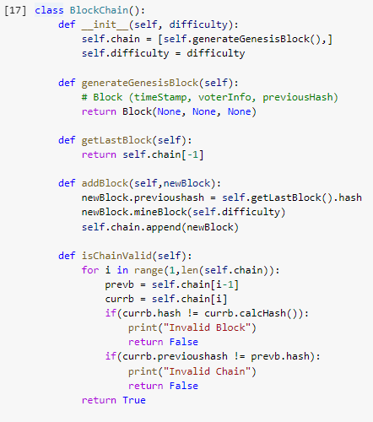
class ‘Blockchain’

Slide 37
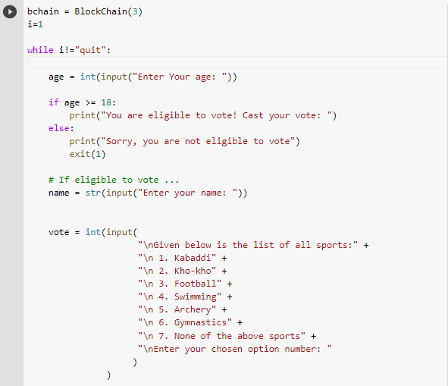
Main codescript

Slide 38
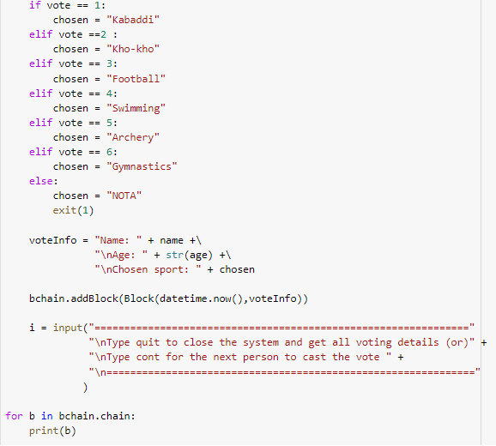

Slide 39
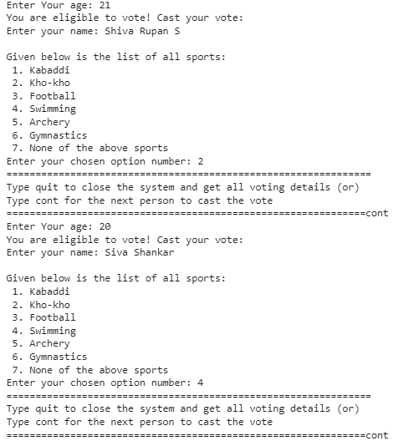
Functioning of the Voting system

Slide 40
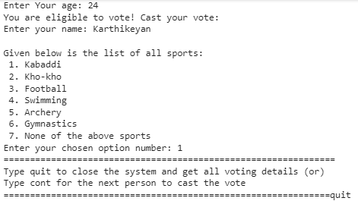

Slide 41
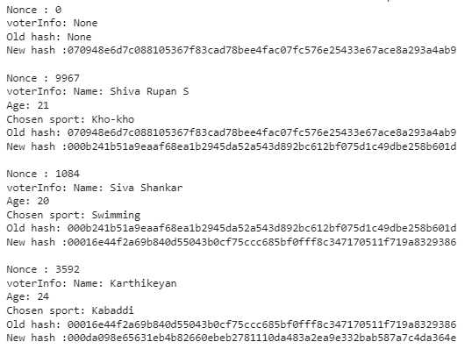
Information stored in the Blockchain

Slide 42
Advantages of using Blockchains
Transparency: Since it is a distributed ledger, changes such as transaction history can be seen by everyone. This is one of the advantages in using cryptocurrencies.
Traceability: With blockchain, there is an audit trail to find the place of origin, and destination of a particular asset. This helps verify the authenticity of deliverables. With smart contracts, anybody can see how and where an asset moves in real-time.
Security: Because of immutability, records cannot be altered therefore preventing fraud and unauthorized activity. Privacy issues can also be addressed on blockchain by anonymizing personal data and using permissions to prevent access.
Consensus: The shared documentation of transactions can only be updated and/or modified with on a blockchain network. Only if everyone, or a majority of nodes agree to update, the information is edited. Moreover, when a transaction is approved, it is encrypted and connected with the previous transaction. Therefore, no one person or a party has the potential to alter the record.

Slide 43
5) Increased efficiency and speed: Blockchain eliminates paper-heavy work prone to human error. By transactions can be completed faster and more efficiently. There is also no need to reconcile multiple ledgers, so clearing and settlement can be much faster.
6) Automation: Transactions can be automated with “smart contracts”. Once pre-specified conditions are met, next steps in transaction are automatically triggered.
Smart contracts reduce human and third party dependence to verify that terms of a contract have been met.
Ex: In insurance, once a customer has provided all necessary documentation to file a claim, the claim can automatically be settled and paid.

Slide 44
Drawbacks of using Blockchains
High Energy Consumption: Mining involves heavy computation. It involves finding numeric solutions to complex math problems. A new block has to be mined for every incoming transaction
Immutability: Though supply chains, transaction records, etc. benefit from immutability, it can also be a problem.
Storage & speed: Storage is a problem since every node stores a copy of the blockchain. With this, the issue of storage arises. As the blockchain adds more nodes, the whole network is slowed down.
Ex: In commercial setups like banks, millions of transactions happening every minute. Blockchains can be problematic in such cases

Slide 45
4) Cost and Implementation: Though blockchain solutions like Hyperledger are open source, huge investment is needed from organizations using them. They have to hire blockchain developers with different specializations, and also invest on maintenance.
For enterprise level projects, the funds required can even shoot up to millions.
5) Private keys: With decentralization comes authorization. So, every user needs a private key. However, if users lose their keys, they will permanently lose their wallets. Therefore, a managing authority for key-keeping is needed. But, this will be ironic to blockchains being ‘decentralized’.

Slide 46
Applications of Blockchains
Financial Exchanges: Many companies now offer decentralized cryptocurrency exchanges. Such transactions are fast and less expensive. Also, investors need not deposit their assets with a centralized authority, which means they have greater control and security.
Secure Personal Information: Storing data such as Social Security numbers, date of birth, etc. in a public ledger (e.g., a blockchain) is less susceptible to hacks.
Securely share medical information: Keeping medical records on a blockchain can allow doctors and medical professionals to obtain accurate and up-to-date information on their patients. That can ensure that patients seeing multiple doctors get the best care possible. It can also speed up the system for pulling medical records, allowing for more timely treatment in some cases. And, if insurance information is held in the database, doctors can easily verify whether a patient is insured and their treatment is covered.

Slide 47
4) Non-Fungible Tokens: Blockchain prevents data from existing in two places, putting an NFT on the blockchain guarantees that only a single copy of a piece of digital art exists. That can make it like investing in physical art but without the drawbacks of storage and maintenance.
5) Logistics and Supply Chain Tracking:
Using blockchain technology to track items as they move through a logistics or supply chain network can provide several advantages. First of all, it provides greater ease of communication between partners since data is available on a secure public ledger.
Secondly , it provides greater security and data integrity since the data on the blockchain can't be altered. That means logistics and supply chain partners can work together more easily with greater trust that the data they're provided is accurate and up to date.

Slide 48
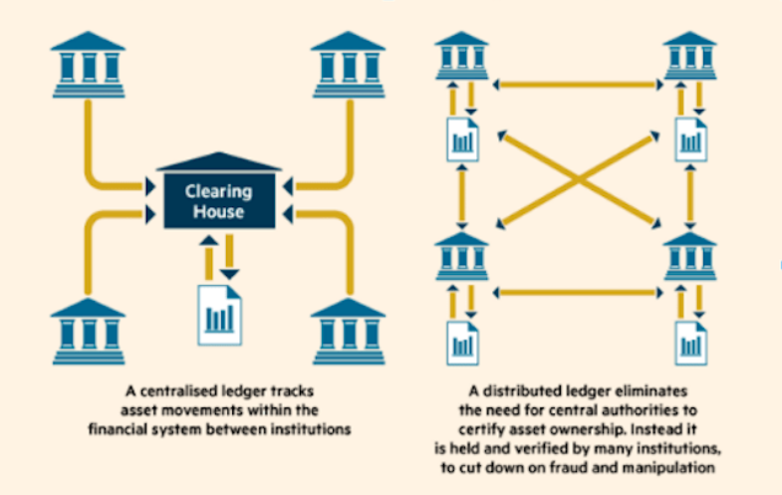
Source: https://www.cbinsights.com/research/blockchain-disrupting-banking/

Slide 49
Conclusion & Future work
Thus, our project has gone from a simple implementation of blockchain to implementing an immutable network of voting information. Thus, we have implemented a simple blockchain-based voting system in Python.
Further, an authentication system involving username and password of users can be implemented in the future. In other words, an end-to-end system for implementing blockchains can be created. Private keys can be provided to users in order to create a locker-like access to information.
Blockchain technology provides verification efficiencies, including operational, regulatory, enhanced visibility, and traceability. This technology is also a powerful database that could easily be combined with big data. Blockchain solutions can help cut costs and make many services more competitive.

Slide 50
THANK YOU!

